Slide 1
STOCK MARKET
ANALYSIS

Slide 2

BY:
NASLA K V
GAURAV CHATURVEDI MUHAMMED ASEEM
RAGHAVENDRA B
PASHAM RAHUL REDDY NITHIN SAI KOMATINENI CHORAGUDI SRI SHIVANI

Slide 3
WHAT IS EDA?
EDA HELPS IN:
UNDERSTANDING DATA STRUCTURE AND DISTRIBUTION DETECTING MISSING VALUES OR OUTLIERS
DISCOVERING PATTERNS, CORRELATIONS, AND RELATIONSHIPS IN VARIABLES.
UNDERSTAND HIDDEN PATTERNS, DETECT ANOMALIES, AND TEST ASSUMPTIONS IN DATA.
EDA stands for Exploratory Data Analysis
The initial process of investigating datasets and their main characteristics.
It involves exploring data before building models to ensure accuracy, consistency, and relevance.

Slide 4
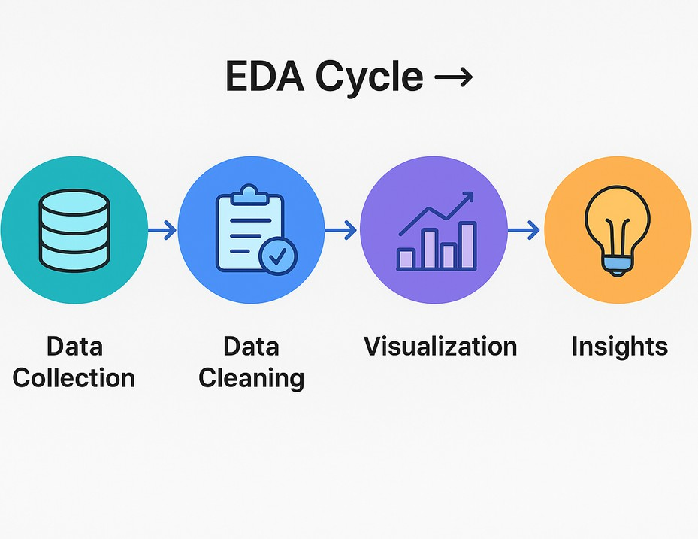


In our stock market analysis, EDA is essential to:
IMPORTANCE OF EDA IN STOCK MARKET ANALYSIS
Identify trends and relationships between stock variables.
Understand market behavior and volatility.
Make better investment predictions based on data-driven insights.
Identifies Outliers or Anomalies

Slide 5
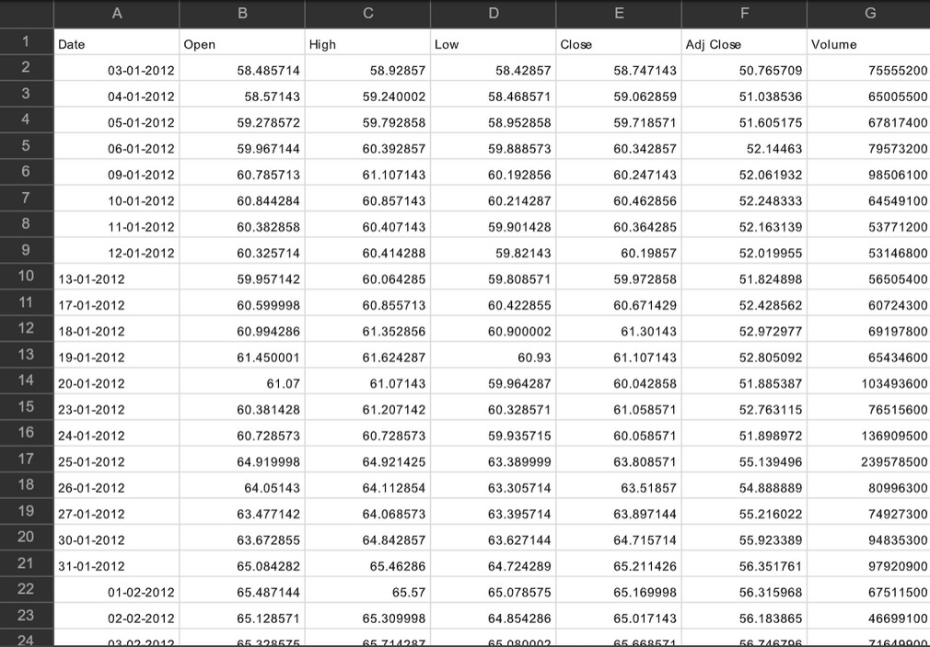

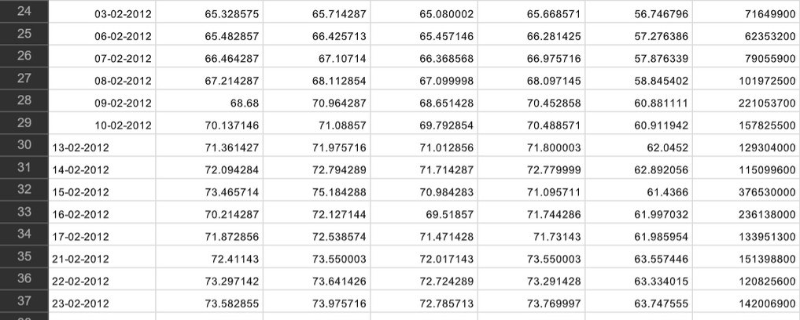
OUR DATASET OVERVIEW
Dataset Name: AAPL.csv (Apple Inc. Stock Market Dataset)
Purpose: To analyze Apple’s stock performance from 2012 to 2019, detect trends, and explore relationships between variables using EDA.
TIME PERIOD COVERED
From: January 3, 2012
To: December 30, 2019 Total Records: 2,011 rows Columns: 7 features

Slide 6


DATA CLEANING
Before performing Exploratory Data Analysis (EDA), data must be cleaned to ensure accuracy, consistency, and reliability of results.
Steps in Data Cleaning Handling Missing Values
Identify and handle null or NaN values using imputation or removal. Example: df.dropna() or df.fillna(method='ffill')
Removing Duplicates
Eliminate duplicate rows to avoid bias in analysis. For instance, deleting rows with the same Date helps prevent redundancy, but it should be done carefully since it may influence the model’s accuracy later. Example: df.drop_duplicates(inplace=True)
Converting Data Types
Convert columns like “Date” to datetime and ensure numeric fields are properly typed. Example: df['Date'] = pd.to_datetime(df['Date'])
Feature Selection
Select relevant columns (e.g., Date, Open, High, Low, Close, Volume) for EDA and drop unnecessary ones. Example: df = df[['Date', 'Open', 'High', 'Low', 'Close', 'Adj Close', 'Volume']]

Slide 7
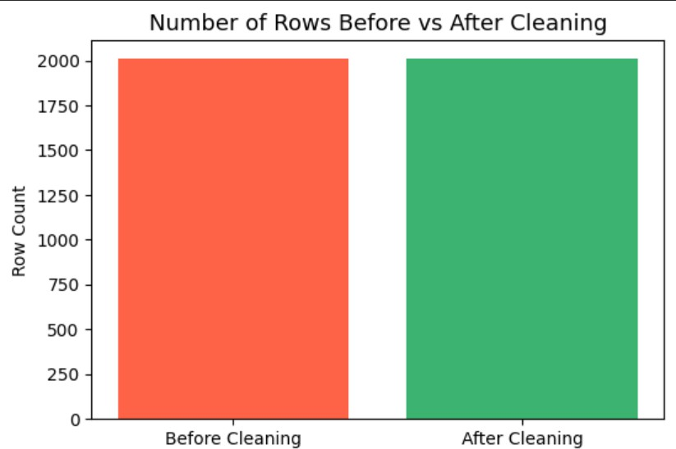
DATA CLEANING

Slide 8
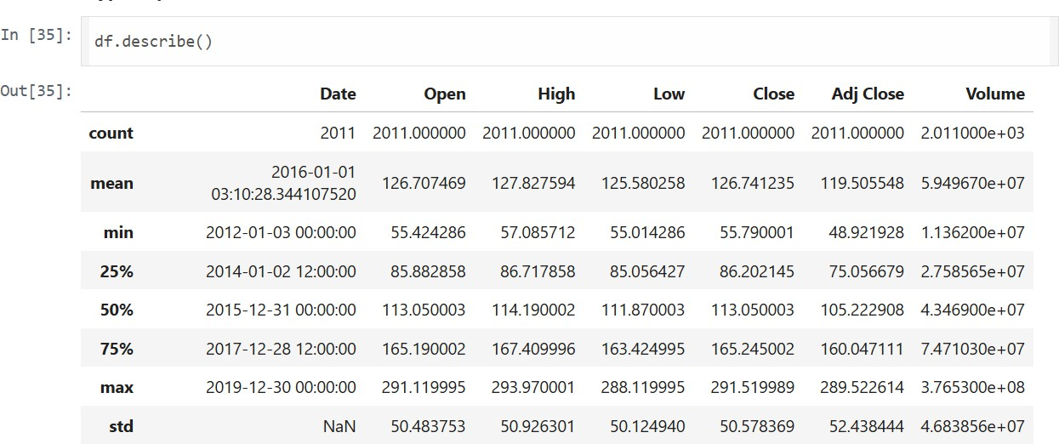
EDA ON OUR DATASET
DESCRIPTIVE STATISTICS (MEAN, MEDIAN, MODE)
Gives a quick summary of central tendency of stock prices.

Slide 9
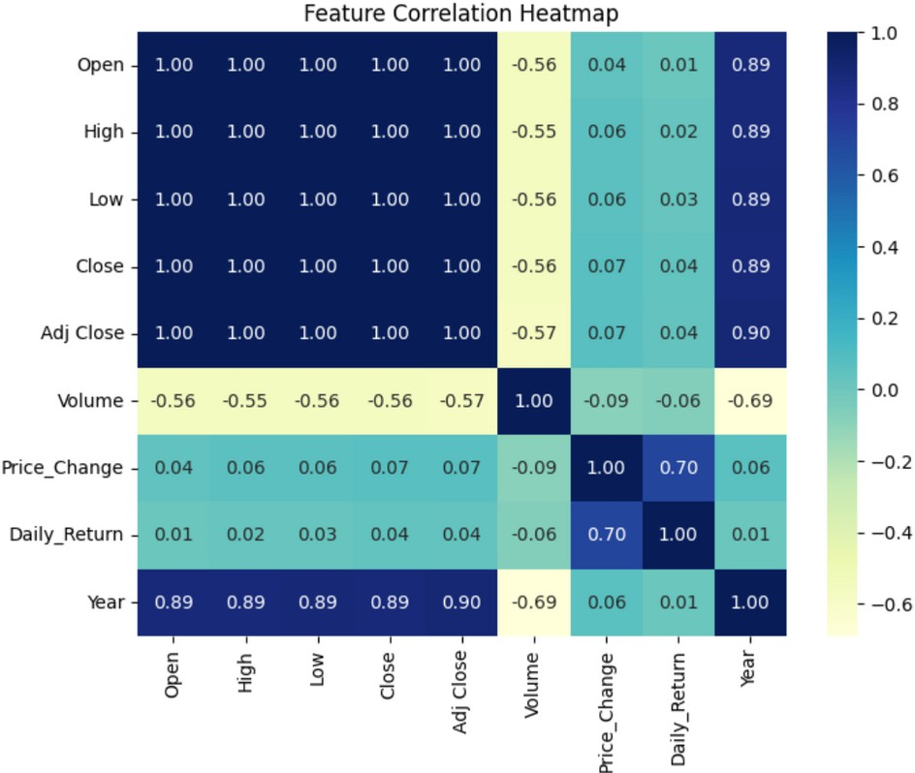
CORRELATION BETWEEN FEATURES
Shows which features move together — e.g., Close vs Volume.

Slide 10
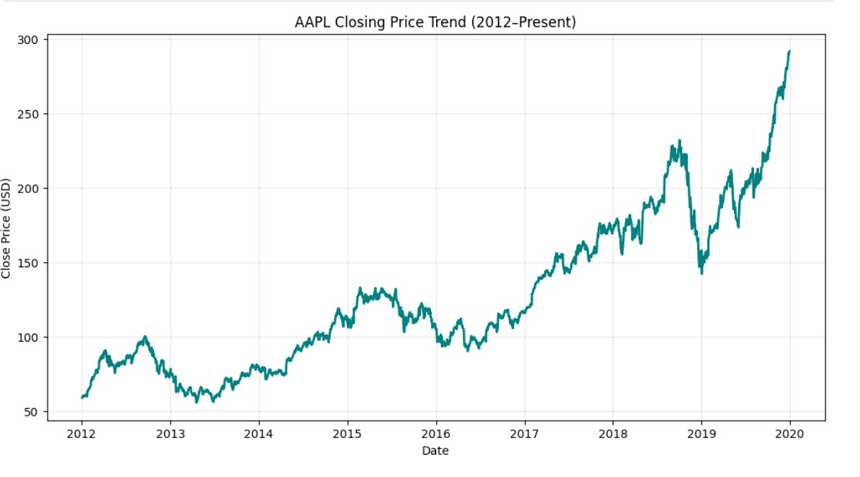
TIME SERIES TREND (LINE GRAPH)
Shows how stock prices move over time.

Slide 11
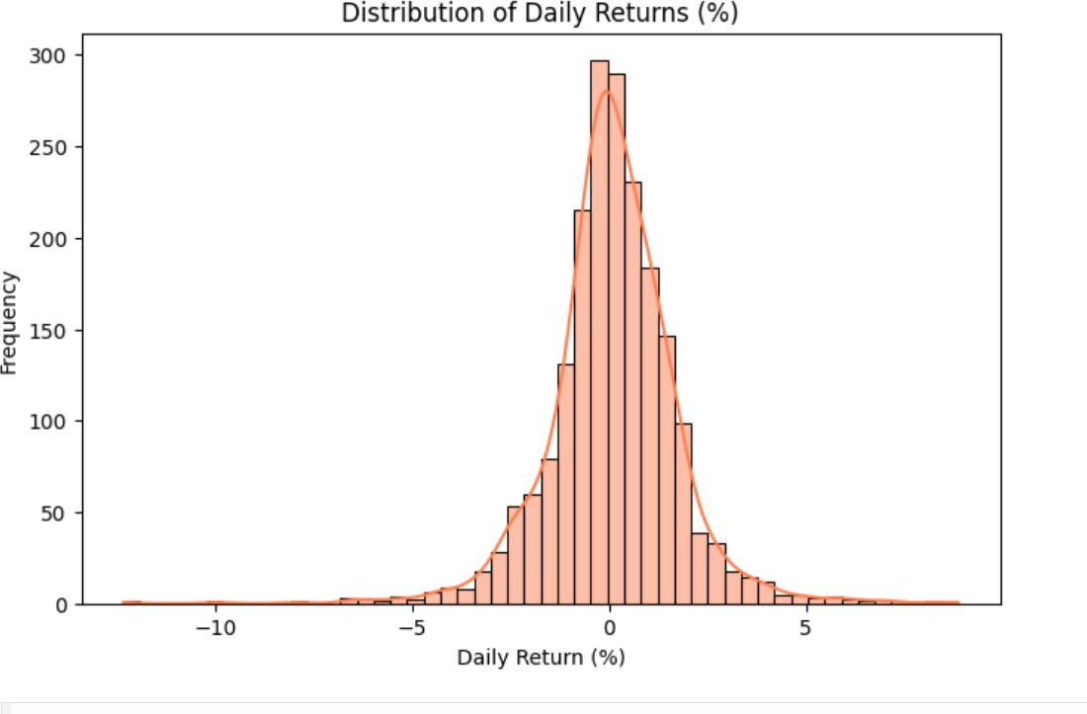
DISTRIBUTION ANALYSIS
Shows how prices are distributed

Slide 12
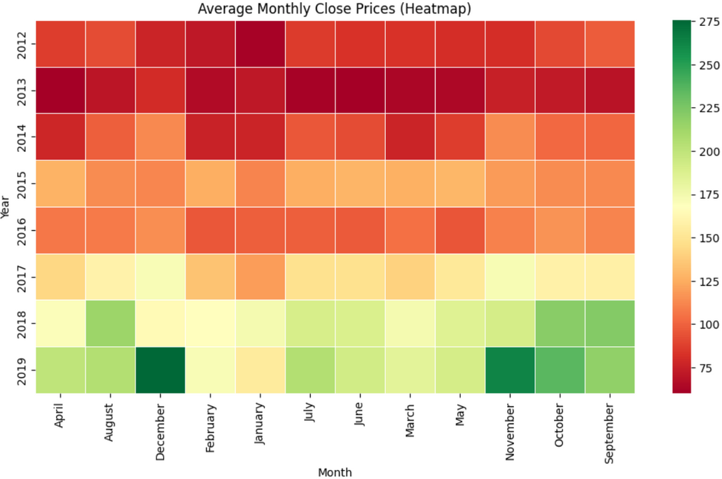
Seasonal Price Patterns
The color variations across months reveal cyclic or seasonal effects in price averages. Distinct seasonal patterns, with stronger performance in Q2–Q3 months.

Slide 13
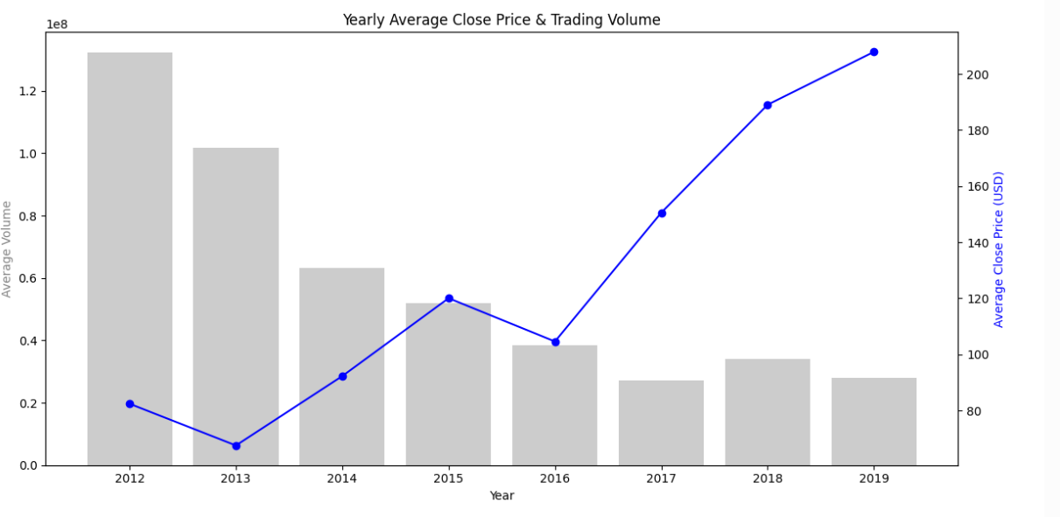
Volume Spikes Correspond to Market Events
The bar + line combo shows sudden trading volume surges, often linked to external news or events. Volume spikes reflect investor reaction to major market news.

Slide 14
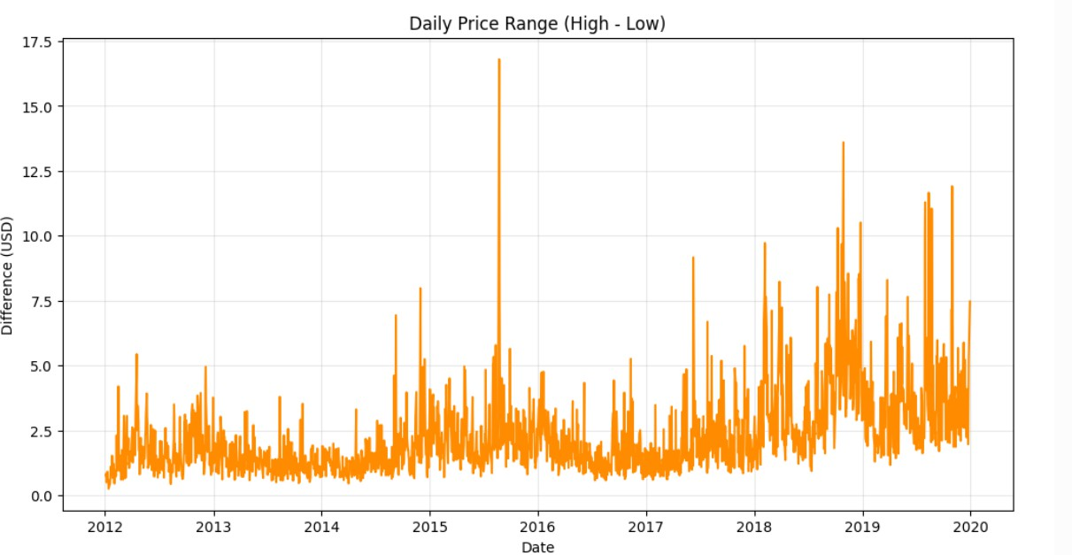
Sudden Fluctuations & Volatility
Shows intraday volatility spikes and can be tied to market stress events.
Sharp spikes in 2018–2019 indicate market turbulence and rapid trading changes.

Slide 15
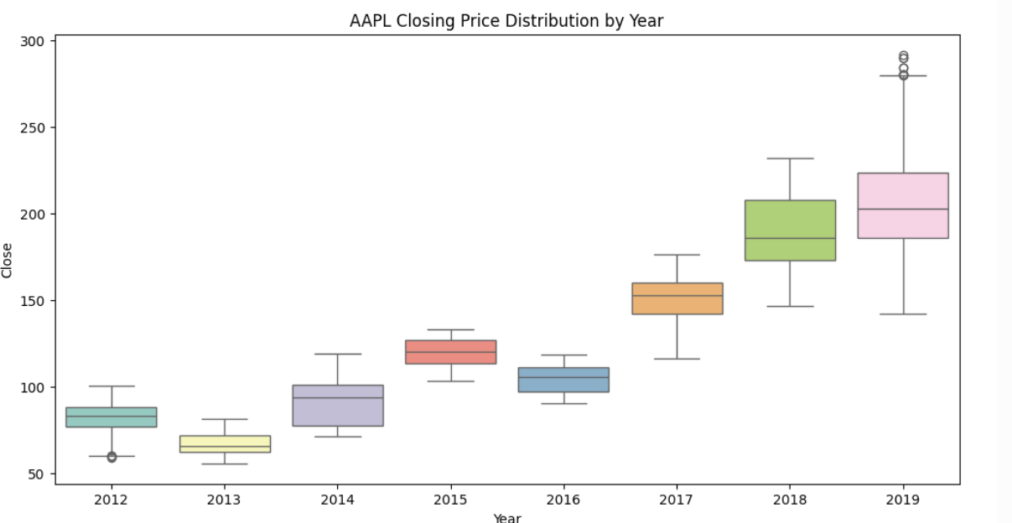
Outliers During High Volatility Periods
Boxplots visually capture outliers and spread during market volatility. 2019 shows multiple outliers — signs of high volatility.

Slide 16
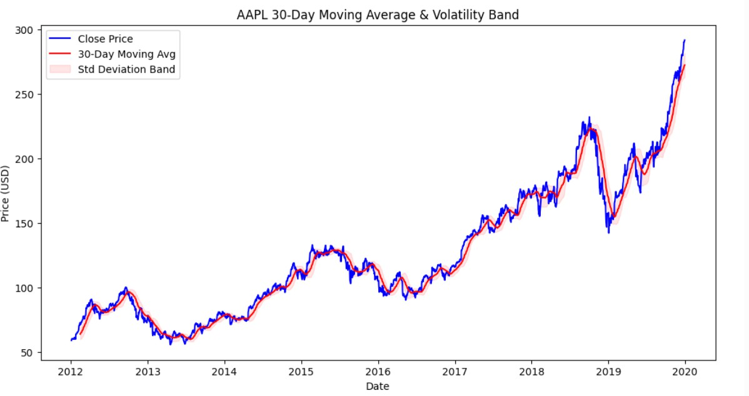
KEY FINDINGS FROM EDA:
Upward Trend Post-2020
It shows the overall growth in stock prices and the volatility bands highlight fluctuations. Consistent upward trend after 2019, indicating strong market recovery.

Slide 17
TEAM UPDATE
Data Cleaning: Handled missing values, removed duplicates including rows with the same Date, and converted data types to ensure consistency and accuracy.
EDA Planning: All team members actively contributed ideas on how to perform Exploratory Data Analysis (EDA) on the dataset — including identifying suitable graphs, key statistical measures, and correlation analysis methods.
Visualization Setup: Discussed and finalized chart types (line graphs, correlation heatmaps, volume trends, and moving averages) to effectively represent key insights.
Collaboration: Combined everyone’s suggestions to develop a well-structured EDA workflow for a clearer understanding of stock behavior and market trends.

Slide 18
HOW WE OVERCAME THEM
CHALLENGES FACED
Used moving averages and line charts to
highlight long-term price movement.
Applied data-cleaning methods like forward-filling and duplicate removal.
Analyzed outliers separately to retain market insights instead of removing them blindly.
Used a correlation heatmap to focus on key influencing features.
Simplified the visuals by selecting the most meaningful and clear charts.
Identifying Trends
Missing or Noisy Data Dealing with Outliers High Feature Correlation Choosing Effective Visuals

Slide 19
NEXT STEPS
Model Building :
We will now focus on building predictive models for stock price forecasting using time series analysis.
Baseline Model:
Initially, a simple baseline model will be developed to set a performance benchmark for future advanced models.
Advanced Models:
We plan to use ARIMAX (AutoRegressive Integrated Moving Average with Exogenous variables) and SARIMAX (Seasonal ARIMAX) models to capture both trend and seasonality in stock data.
Evaluation:
Model performance will be measured using metrics such as RMSE, MAE, and R² to determine forecasting accuracy.
Future Integration:
Once the best model is selected, we aim to integrate it into an interactive dashboard for real-time stock prediction visualization.

Slide 20

THANK
YOU

